Slide 1
Team ATM
Andrew Gacek, Tim Chan, Matthew Nolan

Slide 2
Times
Unfortunately, our group did not finish. We would get most of the way through the competition codes and then crash.
However, we did manage to implement some cool advanced features that are functional on their own.

Slide 3
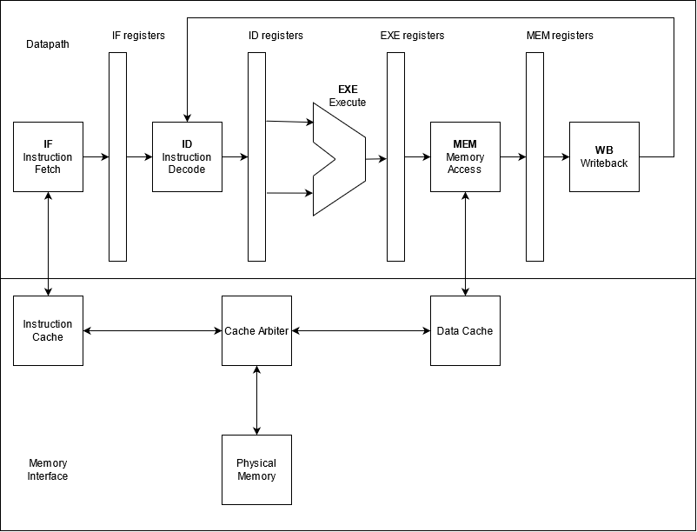
Processor Design
Overall Design:
5-stage pipelined processor with hazard detection and handling, and forwarding
Advanced Features:
M-extension
Parameterized cache
TAGE Branch Predictor

Slide 5
Advanced Feature Performance
M-extension:
Without multiplier, multiplication takes 884 cycles (8840ns)
With basic add-shift multiplier, multiplication takes 32 cycles (320ns)
With advanced Wallace multiplier, multiplication takes 1 cycle (10ns)

Slide 6
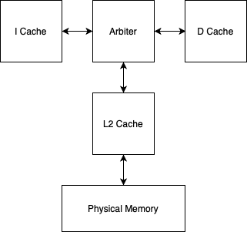
Advanced Feature Description
Parameterized L2-Cache
Single cache connected between arbiter and physical memory
Parameterized number of ways and sets
Replaced default LRU with a pseudo LRU design

Slide 7
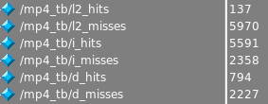
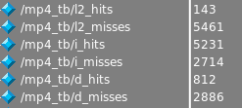
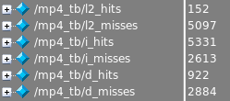
Performance
Parameterized Cache:
2 sets 2 ways
8 sets 4 ways
4 sets 2 ways
16 sets 4 ways

Slide 8
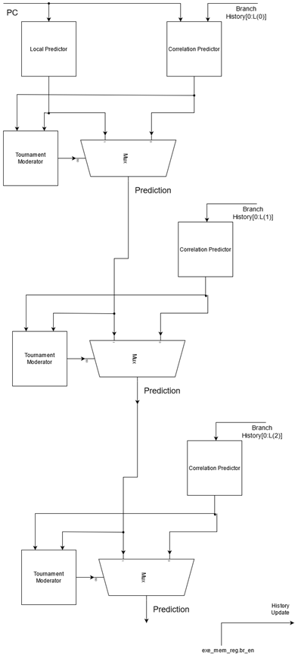
TAGE Branch Predictor
We chose the TAGE branch predictor. This was implemented with the help of the paper “The L-TAGE Branch Predictor” by André Seznec.
The basic idea is to create a hierarchical tournament of different correlated branch predictors.

Slide 9
Branch Predictor Results
Simple Example Code Run to Highlight the Performance of the different predictors.
Predictor | # Taken | # Not Taken | # Correct | # Incorrect | Accuracy (%)
Local Predictor | 293 | 130 | 380 | 43 | 89.8
Correlated- History = 1 | 131 | 292 | 294 | 129 | 69.5
Correlated- History = 2 | 255 | 168 | 418 | 5 | 98.8
Correlated- History = 3 | 42 | 381 | 131 | 292 | 31.0
Final Prediction | 255 | 168 | 418 | 5 | 98.8

